Slide 1
Programming with B4X
Lesson 12 – Loops
Anywhere Software
March 2021

Slide 2
Today you will learn
What are Loops?
For – Next
Do Until
Algorithms with loops
Do While

Slide 3

What are Loops?
Log(1)
Log(2)
Log(3)
Log(4)
Log(5)
..
Log(1000)
A computer programmer who has to use the same lines of code multiple times in a program can use a loop to save time, space, ease of programming.
Notes:
Repetitive structures are one of the most basic functions of a programming language.

Slide 4

What are Loops?
Number
1
1000
2
4
1001
3
Number = 1
No
Is Number <= 1000 ?
Yes
Log(Number)
Increase Number by 1
Notes:
A loop in a computer program is a directive that repeats until a specified condition is reached. In a repeat structure, the loop poses a question. If the answer requires action, it runs. The same question is asked over and over again until no further action is required. Every time the question is asked it is called repetition.
Repeats have to end at some point or it's a programming error. A repetition that never ends is called an endless loop. In this case the computer is trapped in a perpetual repetition of the same functions without "awareness" of vanity!

Slide 5
Do While
Do While Condition
Commands
...
Loop
As long as the condition is true
Execute the Commands
...
Go back to condition.

Slide 6
Do While Example
Log(1)
Log(2)
Log(3)
Log(4)
Log(5)
Private i As Int = 1
Do While i <= 5
Log(i)
i = i + 1
Loop
Counter
Condition
Step
When the counter starts at a value less than the final value then the step must be positive.
When the counter starts from a value greater than the final value then the step must be negative.
Notes:
Variable i counts how many times the loop will run.
The Condition also examines whether the contents of the counter exceeded the limit set by the developer, i.e. 5, and if this happens, the repetition stops.
Before the loop iteration end, the repeat counter is increased by +1. This value is also called Step.
The step can be positive or negative, but it can never be 0 because then the repetition would run forever.

Slide 7
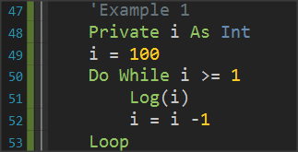
Example 1 - Show all integers from 100 to 1
Notes:
In the example the repeat counter it starts at a large value (100) and ends at a small (0) before the repetition is complete. Attention in this case to the Step is Negative (-1)

Slide 8
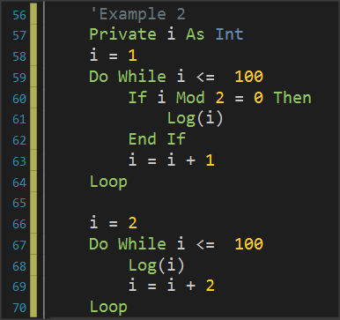
Example 2 - Show all even numbers from 1 to 100
Notes:
Here are two solutions presented the first uses a command if in loop to check whether the number is even and only then executes the command Log. In the second algorithm has changed the starting value of the i in 2 and the Step increases by 2 which creates a faster algorithm to run.

Slide 9
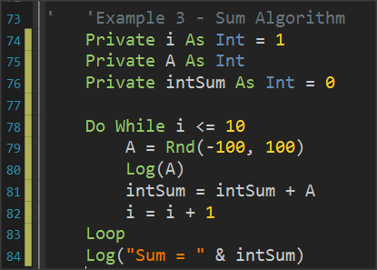
Example 3 – Sum Algorithm
Make a program that for ten numbers entered, the program calculates their sum. These numbers are considered to range between -100 and 100
The Rnd command returns a number between the First and Last value.

Slide 10
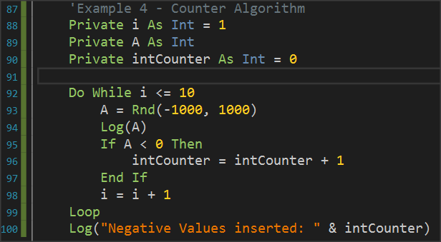
Example 4 – Count Algorithm
Make a program that for ten numbers entered, the program calculates the number of negatives. These numbers are considered to range between -1000 and 1000

Slide 11
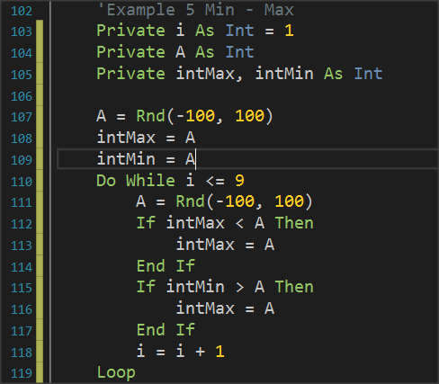
Example 5 - Maximum Algorithm - Minimum
First read a number out-side the while.
Set as the starting value in the intMax, intMin variables the first number since there is no one else to compare.
For each new number
if it is less than intMin then intMin replaced by A
if the new A is greater than intMax the intMax is replaced with the new A.

Slide 12
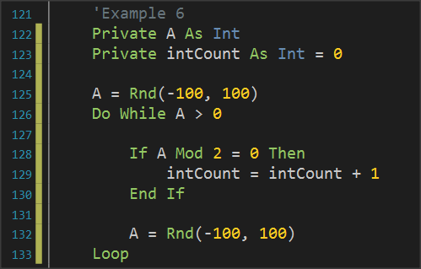
Loops with unknow repeats.
Create a program that constantly reads numbers and calculates the Averages of the even. The program stops when a number less than 0 is entered.
First read a number outside the repetition.
The DoWhile condition checks whether the number A is within the limits.
A new number is read before the end of the iteration.
Notes:
Often in programming we do not know from the beginning the number of repetitions. This usually happens when the repeat depends on the value taken from user or on values calculated during the repeat.

Slide 13
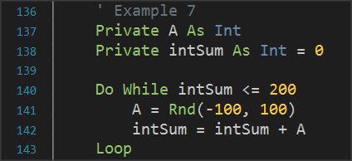
Example 7 – Non-specific number of repetitions
Create a program that reads numbers and calculates their sum. The program stops when the sum exceeds 200.
The condition checks whether the total has not reached the limit of 200.
A number is read and then program calculates the sum. Condition checked again by Do While.

Slide 14
The Do Until command
Do While Condition
Commands
...
Loop
Do Until Condition
Commands
...
Loop
Remember
The condition of Do While is the denial of Do Until.
controls how long it will work
when a repetition will end
Notes:
The operation of the Do Until is like the Do While. The only difference is the condition which controls when a repetition will end as opposed to the Do While which controls how long it will work. In both cases the check shall be carried out at the beginning, in which case the code shall not be executed if the Condition is False.

Slide 15
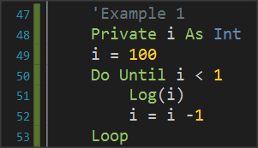
Example 1 - Show all integers from 100 to 1
Notes:
In the example the repetition counter it starts at a large value (100) and ends at a small (0) before the repetition is complete. Attention in this case to the Step as it is Negative (-1)

Slide 16
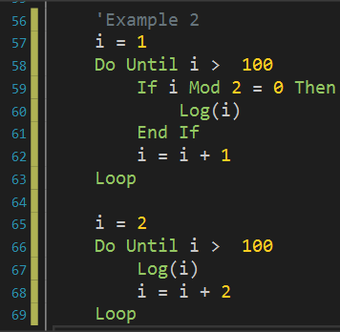
Example 2 - Show all even numbers from 1 to 100
?
?

Slide 17
Example 3 – Sum Algorithm
Make a program that for ten numbers entered, the program calculates their sum. These numbers are considered to range between -100 and 100
Until I > 10
?

Slide 18
Example 4 – Count Algorithm
Make a program that for ten numbers entered, the program calculates the number of negatives. These numbers are considered to range between -1000 and 1000
?
Do Until i > 10

Slide 19
Example 5 - Maximum Algorithm - Minimum
Do Until i > 9
?

Slide 20
Loops with unknow repeats.
Create a program that constantly reads numbers and calculates the Averages of the even. The program stops when a number less than 0 is entered.
?
Do Until A <= 0

Slide 21
Example 7 – Non-specific number of repetitions
Create a program that reads numbers and calculates their sum. The program stops when the sum exceeds 200.
Do Until intSum > 200
?

Slide 22
For loop
for i = n1 to n2 Step n3
Commands
...
Next
Where:
i the Counter variable
n1 the initial value of the Counter
n2 the final value
n3 step of repetition
Notes:
At the beginning of repetition, variable ‘i’ accepts n1.
Executes commands within the repetition.
At the end of the repetition the value of ‘i’ increases or decreases by n3
Check if ‘i’ has exceeded the final value n2.
if the step is positive and ‘i’ is less than or equal to the final value then the repeat runs again
If the step is negative and ‘i’ is greater than or equal to the final value, then the repeat runs again.

Slide 23
Remember
In relation to Do While and Do Until the For:
Do not needs to initialize the counter.
Do not needs to set the step change operation.
It is always for measurable repeats (however, you can use the exit command to get out of it at any time).

Slide 24
Examples – Describe what these codes do
‘Example 1
Private i As Int
For i = 100 to 1 step -1
Log(i)
Next
‘Example 2
Private i As Int
For i = 1 to 100
If i mod 2 = 0 then
Log(i)
End If
Next

Slide 25

Thank you!!!

